Slide 1

GROUP 13
THE UNIVERSTY OF DODOMA
COLLEGE OF INFORMATICS AND VIRTUAL EDUCATION
DEPARTMENT OF COMPUTER SCIENCE AND ENGINEERING (CSE)
PROJECT PROPOSAL
TITLE: IOT-BASED SMART ROAD DAMAGE DETECTION AND WARNING SYSTEM.
S/N | NAME | REG.NUMBER | PROGRAMME
1 | MAGID LUSANGIJA | T21-03-05219 | BSc. CE4
2 | FIDELIS M. KAGASHE | T21-03-12740 | BSc. CE4
3 | THOMAS V. THOMAS | T21-03-00997 | BSc. CE4
4 | PASCHAL S. MBELELE | T21-03-02213 | BSc. CE4
5 | MESHACK V. BUNDALA | T21-03-15154 | BSc. CE4

Slide 2
INTRODUCTION
The worsening condition of roads, especially during the rainy season, creates serious risks for drivers. When roads get damaged, it can lead to accidents, tire bursts, vehicle damage, and higher maintenance costs.
In Tanzania, particularly on the KibaigwaDodoma road, drivers often face these problems. To solve this issue, we propose an IoT-based smart road damage detection and warning system. This system will help improve road safety by detecting hazards and alerting drivers, reducing accidents, and minimizing economic losses.

Slide 3
Problem Statement
Potholes formed due to rain and road degradation causes damage to vehicle tires, leading to accidents and economic losses. Drivers lack an efficient system to detect and avoid road damage in realtime.
So we proposed an IoT-Based Smart Road Damage Detection and warning system that can detect the potholes and alert the drivers, helping them to avoid damaged roads and reduce accident

Slide 4
OBJECTIVES
Main Objective
To design the IoT-Based Smart Road Damage Detection and warning system
Specific Objective
To gather the system requirements
To design the system that detect road damage using ultrasonic sensor
To track the record damaged road locations using GPS Tracking.
To implement the IoT-Based Smart Road Damage Detection and warning system

Slide 5
System Requirements
Functional requirements.
The system shall be able to detect the Road Damage Using ultrasonic sensor.
The system shall be able to Precise location tracking of damaged areas using GPS Tracking
The system shall be able to Notify drivers via mobile applications, buzzers.
The system shall be able to Utilize GSM or Wi-Fi (Microcontroller) for data transmission.
The system shall be able to store pothole location data in cloud database
The system shall be able to provide a map-based interface showing pothole location.

Slide 6
System Requirements….
Non-Functional Requirements.
The system should operate on low power to ensure long battery life.
The system Should be able to withstand adverse weather conditions.

Slide 7
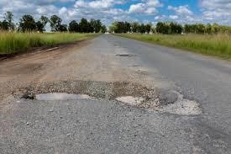
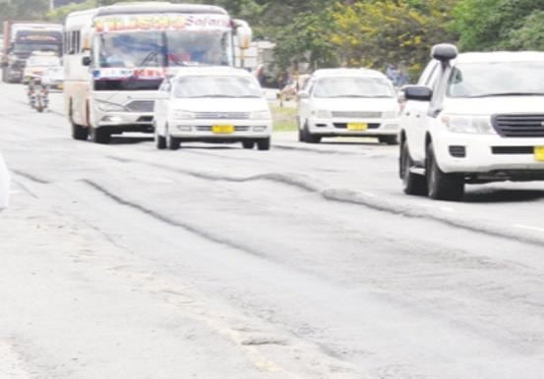
Data collection.
To accomplish the development of this project the data was collected through researching at kibaigwa-Dodoma road by taking some important image showing those damages as follows.
Images that shows those potholes as part of our research.

Slide 8
System Design
Hardware Components
Microcontroller: (for IoT connectivity and processing).
Ultrasonic Sensor: (for detecting road surface issues based on depth measurements).
GPS Module: (for recording location of damaged areas).
GSM Module: (for sending alerts via SMS or internet).
Power Supply: rechargeable battery with voltage regulation.
Buzzer: Alerts drivers about upcoming damaged roads.

Slide 9








BLOCK DIAGRAM
DISPLAY
POWER SUPPLY
ULTRASONIC SENSOR
WEB
-
BASED
(
IOT PLATFORM
)
GSM MODULE
BUZZER

Slide 10
System Design…
WORKING PRINCIPLE
The ultrasonic sensor, placed under a vehicle or mounted on the roadside, continuously scans the road surface.
If a significant road surface issue is detected, it is classified as road damage.
The GPS module records the exact location of the damaged area.
The microcontroller processes the data and transmits it to a cloud database via GSM/Wi-Fi.
Drivers receive real-time alerts through a mobile application or in-vehicle display.

Slide 11
System Design…
Data Processing and Cloud Integration.
The system utilizes cloud storage to log road damage data for analysis and visualization. A web or mobile application provides an interactive map showing damaged locations, helping authorities plan road repairs efficiently.

Slide 12
Outcomes of the system expected:
Improved Road Safety: Drivers receive timely alerts, reducing accidents.
Reduced Vehicle Damage: Avoiding damaged road areas prevents tire bursts and costly repairs.
Efficient Road Maintenance: Authorities can monitor road conditions and take preventive measures.
Cost Savings: Reduced vehicle repair costs and fewer insurance claims.

Slide 13
Conclusion
This IoT-based road damage detection and warning system will significantly improve road safety and transportation efficiency. By integrating sensors, GPS, and cloud technology, the system ensures proactive road damage detection and effective road maintenance.

Slide 14
END

